Slide 1
Animation Merit Badge
Troop 344 and 9344 Pemberville, OH

Slide 2
Requirements
General knowledge. Do the following:
In your own words, describe to your counselor what animation is.
Discuss with your counselor a brief history of animation.
Principles of animation. Choose five of the following 12 principles of animation, and discuss how each one makes an animation appear more believable:
squash and stretch,
anticipation,
staging,
straight-ahead action and pose to pose,
follow through and overlapping action,
slow in and slow out,
arcs,
secondary action,
timing,
exaggeration,
solid drawing,
appeal.

Slide 3
Requirements
Projects. With your counselor's approval, choose two animation techniques and do the following for each:
Plan your animation using thumbnail sketches and/or layout drawings.
Create the animation.
Share your animations with your counselor. Explain how you created each one, and discuss any improvements that could be made.
Animation in our world. Do the following: Tour an animation studio or a business where animation is used, either in person, via video, or via the Internet.
Share what you have learned with your counselor.
Discuss with your counselor how animation might be used in the future to make your life more enjoyable and productive.
Careers. Learn about three career opportunities in animation. Pick one and find out about the education, training, and experience required for this profession. Discuss your findings with your counselor. Explain why this profession might interest you.

Slide 4
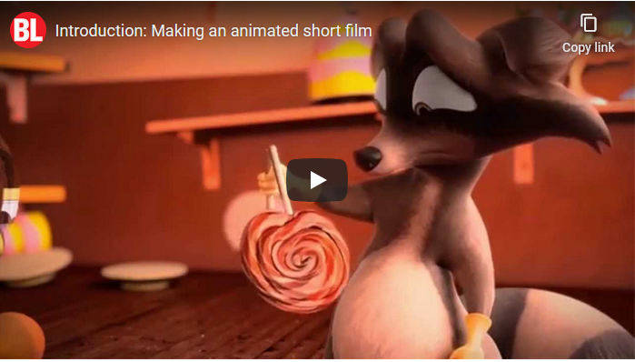
Introduction: Making an Animated Short Film
Click on the above image

Slide 5
Requirements
General knowledge. Do the following:
In your own words, describe to your counselor what animation is.
Discuss with your counselor a brief history of animation.

Slide 6
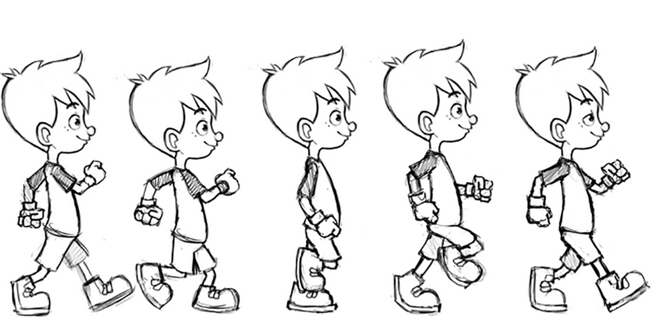
What is Animation
Animation is the capturing of sequential, static images — drawings or photos of inanimate objects — and playing them in rapid succession to mimic real world motion.
If you’ve ever seen a flip book, you know how it works.

Slide 7
Requirements
General knowledge. Do the following:
In your own words, describe to your counselor what animation is.
Discuss with your counselor a brief history of animation.

Slide 8
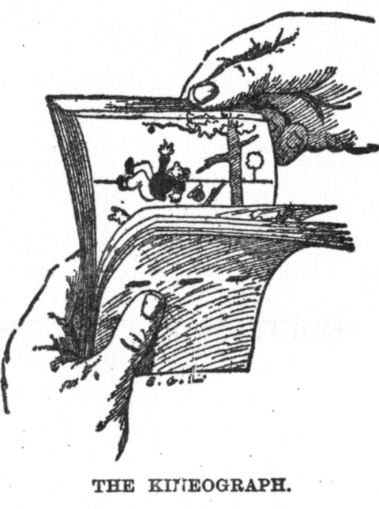
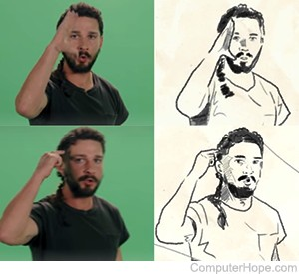
History of Animation
1868 John Barnes Linnett patented the first flip book as the kineograph.
1908 A Frenchman name Emile Cohl produced a film called "Fantasmagorie."
It was a hit, and is known today as the first true animated film.
In 1917, Max Fleischer received a patent for a technique which became known as rotoscoping: the process of using live-action film recordings as a reference point to more easily create realistic animated movements.

Slide 9
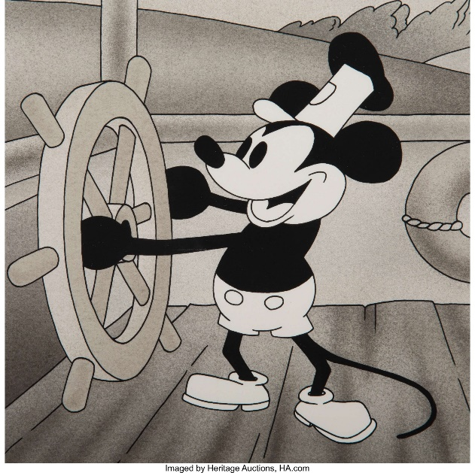
History of Animation
1920 Otto Messmer created a character named Felix the Cat.
Felix was the first cartoon to be merchandised.
1922 Walt Disney began his first animation film studio called Laugh-O-Grams.
It failed after only a short time.
1928 Walt Disney released a short film called Steamboat Willie featuring Mickey Mouse and using sound for the first time.
It was an instant hit.

Slide 10
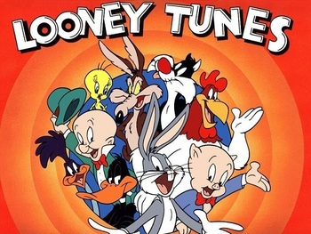
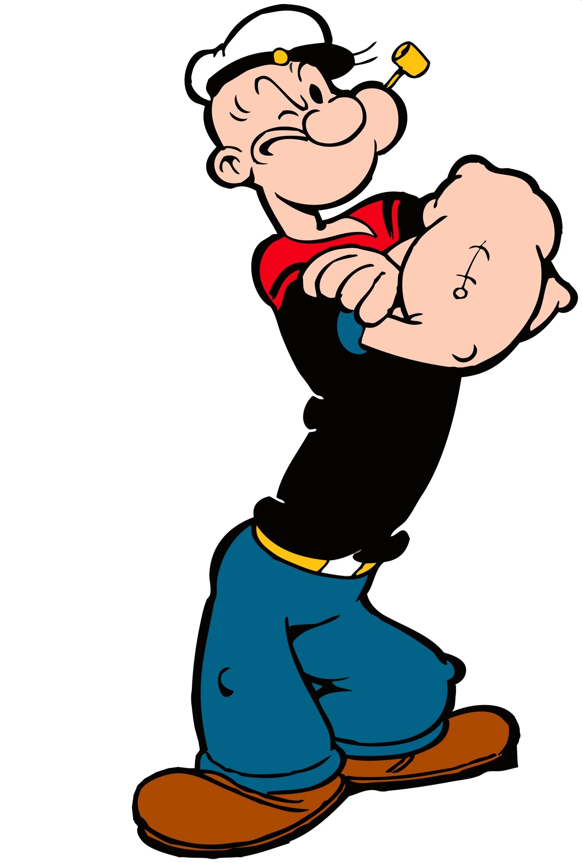
History of Animation
1930 Warner Bros. Studio is born.
Looney Tunes was supposed to be a spin off on the Silly Symphonies produced by Disney.
It soon took on a life of its own and became very popular.
1930’s Several now-iconic characters were created.
This included Betty Boop, Popeye the Sailor, and Daffy Duck.

Slide 11
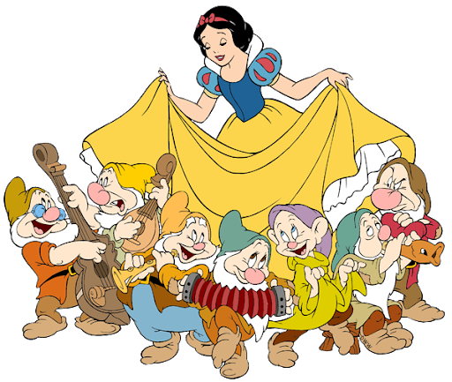
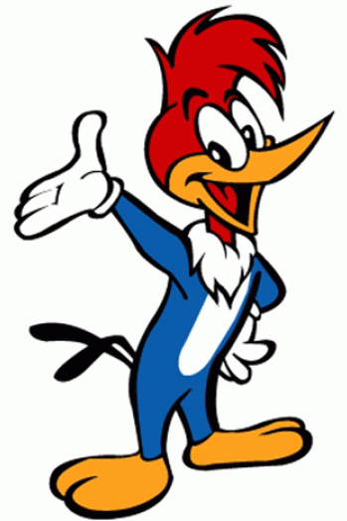
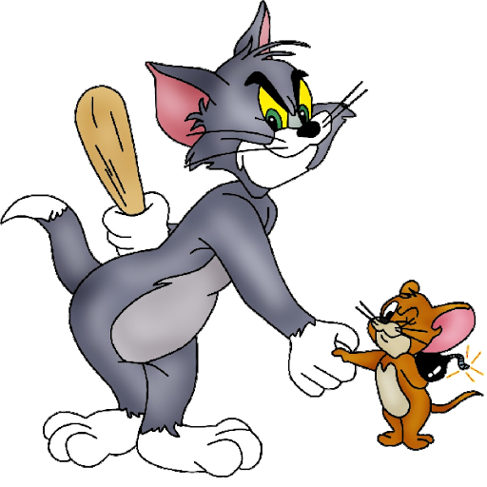
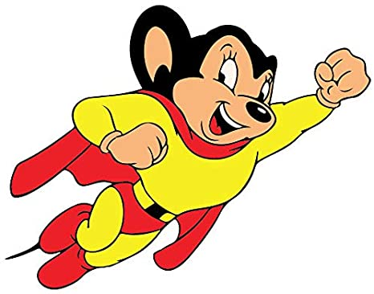
History of Animation
1937 Walt Disney produced the first ever full-length animated film.
Snow White and the Seven Dwarfs was a major hit.
1940’s This decade brought several new popular characters to life including Woody Woodpecker, Mighty Mouse, and Tom and Jerry.

Slide 12
History of Animation
1950s Shift from classic theatrical cartoons to animation in TV series for children.
1960’s Japan was notably prolific and successful with their own style of animation, which became known as anime.
1972 At the University of Utah, a man named Ed Catmull developed a method of creating computer generated movies now known as CGI.

Slide 13
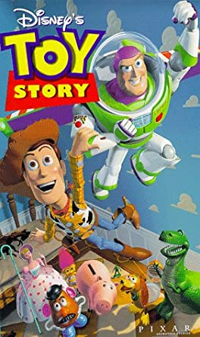
History of Animation
1993 Apple computer company produced a method for creating 3-D films.
1995 Toy Story was released as the first full-length 3-D film.
Computer animation grew into the dominant animation technique in the US and many other countries.

Slide 14
Requirements
General knowledge. Do the following:
In your own words, describe to your counselor what animation is.
Discuss with your counselor a brief history of animation.
Principles of animation. Choose five of the following 12 principles of animation, and discuss how each one makes an animation appear more believable:
squash and stretch,
anticipation,
staging,
straight-ahead action and pose to pose,
follow through and overlapping action,
slow in and slow out,
arcs,
secondary action,
timing,
exaggeration,
solid drawing,
appeal.

Slide 15
The 12 Principles of Animation
The 12 principles of animation were first introduced by Disney animators Ollie Johnston and Frank Thomas in their book The Illusion of Life: Disney Animation, which was first released in 1981.
In this book, Johnston and Thomas examine the work of leading Disney animators from the 1930s and onwards, and boil their approach down to 12 basic principles of animation.
These principles form the basis of all animation work and are relevant for a number of different fields.
The most obvious use is for animating a character.
Once you understand these 12 principles of animation, you'll be able to take your motion work to the next level.
Following the slides describing these principles will be videos demonstrating these principles.

Slide 16
Squash and Stretch
Squash and Stretch is the principle of applying a contrasting change of shape—from a squash pose to a stretch pose or vice versa—to give a feeling of fleshiness, flexibility, and life in animation.

Slide 17
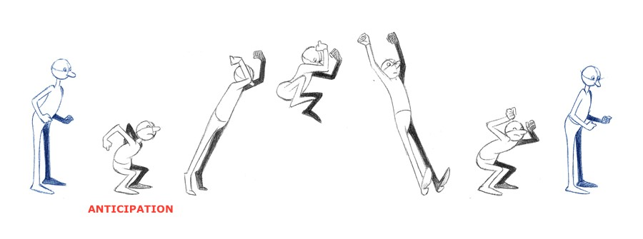
Anticipation
Anticipation is something that tells the audience that a new idea is going to occur.
It prepares them for it so when it happens they can enjoy it and not get caught off-guard.

Slide 18
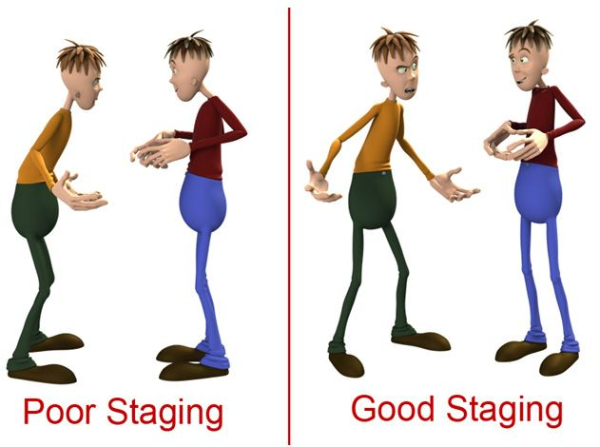
Staging
When filming a scene, where do you put the camera? Where do the actors go? What do you have them do? The combination of all these choices is what we call staging.
Staging is one of the most overlooked principles. It directs the audience’s attention toward the most important elements in a scene in a way that effectively advances the story.

Slide 19
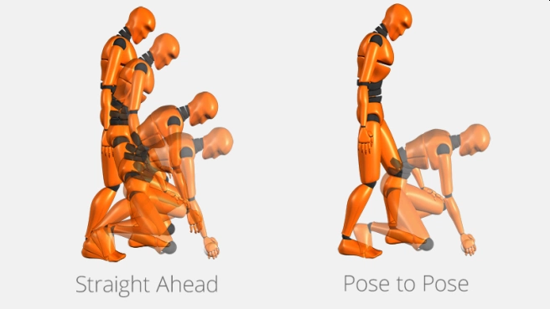
Straight Ahead and Pose to Pose
Straight Ahead Action and Pose to Pose refer to the two drawing processes applied by animators.
Straight Ahead Action is the drawing out of a scene frame by frame from start to finish.
Pose to Pose the action is planned out by the animator using a few key frames and then the intervals are filled in.

Slide 20
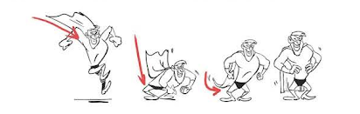
Follow Through and Overlapping Action
When a moving object such as a person comes to a stop, parts might continue to move in the same direction because of the force of forward momentum.
These parts might be hair, clothing, jowls, or jiggling flesh of an overweight person.
This is where you can see follow-through and overlapping action.
The secondary elements (hair, clothing, fat) are following-through on the primary element, and overlapping its action.

Slide 21
Slow In and Slow Out
Slow In and Slow Out describes the tendency of things to come to rest, or to start moving, in a progressive way.
This principle tells us that when we animate something moving from a stop, the spacing of that object needs to progressively increase (widen) until it gets up to speed, at which point the spacing becomes relatively constant.
And when that object comes back to rest, the spacing progressively decreases to zero.

Slide 22
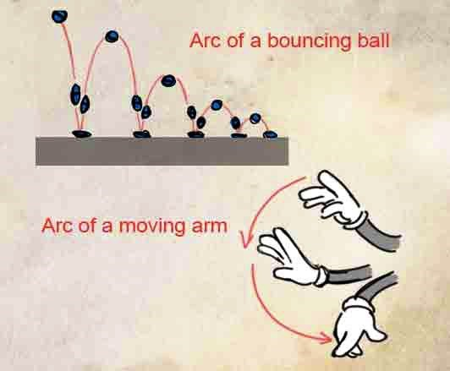
Arcs
The visual path of an object or action is called an “arc”.
This could be the projectile of a bouncing ball, the path of a moving arm, and even the movements of mouth corners during a dialogue scene.

Slide 23
Secondary Action
Secondary actions are gestures that support the main action to add more dimension to character animation.
When a character shakes their head, the head movement is the primary motion, and the movement of the hair and floppy hat are examples of secondary motion.

Slide 24
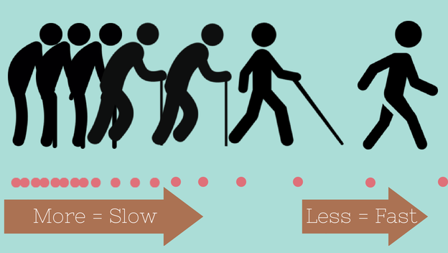
Timing
Timing in animation, refers to the number of frames between two poses.
More drawings/frames between poses gives the viewer a slow and smooth action while fewer drawings/frames gives the viewer a faster and crisper action.
A mixture of both slow and fast timing within a scene gives texture and interest to the movement.

Slide 25
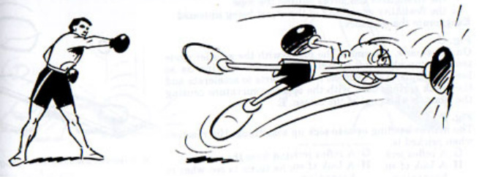
Exaggeration
Exaggeration is used in animation for visual effect.
An action becomes a lot more interesting with exaggeration to make it look more extreme and surreal.
It is the opposite of realism - if we were to animate a perfect imitation; it could look static and dull.

Slide 26
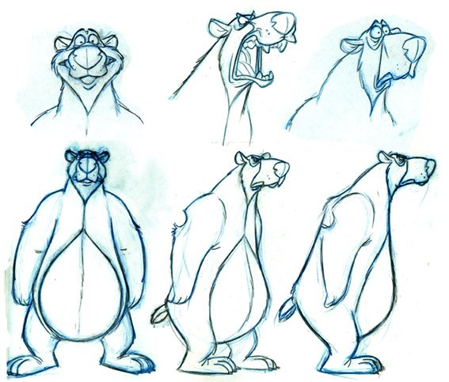
Solid Drawing
By applying solid drawing, an illusion of 3D space is created which adds depth, perspective, and scale to the animation.
Instead of facing the drawing straight on, place it at an angle to give it a 3D weight and provide a more interesting view as shown above.

Slide 27
Appeal
In animation, artists use the Appeal principle to create interesting characters that appeal to the audience.
Appeal can be hard to quantify because everyone has a different standard.
You can give your character a better chance of being appealing by making them attractive to look at.
Enlarging the most defining feature of a character can go a long way to giving the character personality.
Strive for a good balance between detail and simplicity.

Slide 28
12 Principles of Animation Demonstration Videos
Squash and Stretch
Anticipation
Staging
Straight Ahead and Pose to Pose
Follow Through and Overlapping Action
Slow In and Slow Out
Click on the hyperlink to be connected to a YouTube video.

Slide 29
12 Principles of Animation Demonstration Videos
Arcs
Secondary Action
Timing
Exaggeration
Solid Drawing
Appeal
Click on the hyperlink to be connected to a YouTube video.

Slide 30
Requirements
Projects. With your counselor's approval, choose two animation techniques and do the following for each:
Plan your animation using thumbnail sketches and/or layout drawings.
Create the animation.
Share your animations with your counselor. Explain how you created each one, and discuss any improvements that could be made.
Animation in our world. Do the following: Tour an animation studio or a business where animation is used, either in person, via video, or via the Internet.
Share what you have learned with your counselor.
Discuss with your counselor how animation might be used in the future to make your life more enjoyable and productive.
Careers. Learn about three career opportunities in animation. Pick one and find out about the education, training, and experience required for this profession. Discuss your findings with your counselor. Explain why this profession might interest you.

Slide 31
Flipbooks
Create your own flipbook to see animation in action. Here’s how:
Download the PDF template and print it out.
Cut out all the images following the dotted lines. Stack the images in numerical order, and line up the right edges.
Staple the images along the left edge to make a miniature book.
Flip through the pages to see the animated character in action!
Now turn the book over and create your own flip. Or use a few blank sheets of paper and follow the same process.
This is one possible way to create your own animation for requirement 3b.

Slide 32
Requirements
Projects. With your counselor's approval, choose two animation techniques and do the following for each:
Plan your animation using thumbnail sketches and/or layout drawings.
Create the animation.
Share your animations with your counselor. Explain how you created each one, and discuss any improvements that could be made.
Animation in our world. Do the following: Tour an animation studio or a business where animation is used, either in person, via video, or via the Internet.
Share what you have learned with your counselor.
Discuss with your counselor how animation might be used in the future to make your life more enjoyable and productive.
Careers. Learn about three career opportunities in animation. Pick one and find out about the education, training, and experience required for this profession. Discuss your findings with your counselor. Explain why this profession might interest you.

Slide 33
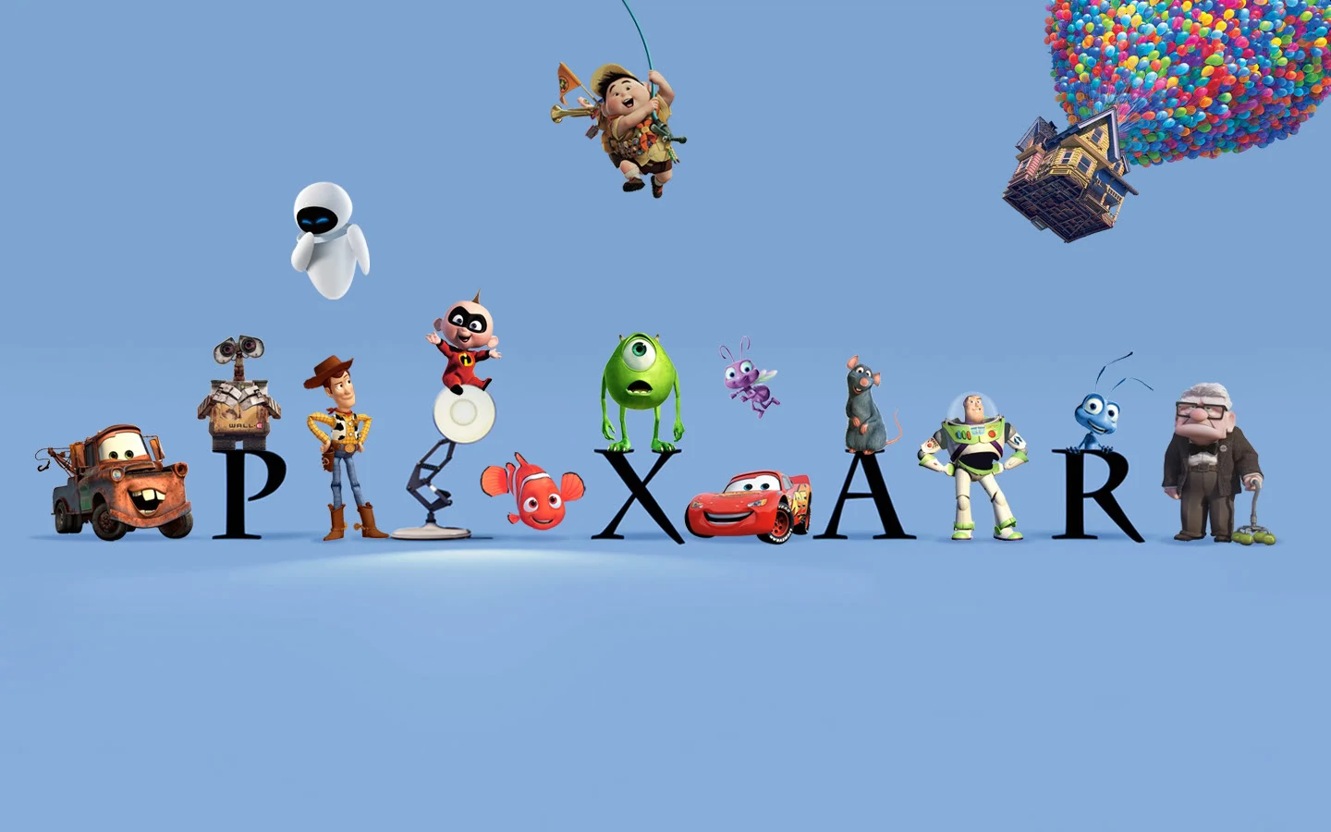
Animation in the World
Pixar Studios
Dreamworks Studio

Slide 34
The Future of Animation
Development of animation has made it a tool for teaching and learning by being fun and engaging.
Increased use of animation has opened the path for many to earn the livelihood by creating the interesting and creative animated videos.
Virtual reality (VR) is a simulated experience that can be similar to or completely different from the real world. Applications of virtual reality can include entertainment (i.e. video games) and educational purposes (i.e. medical or military training).

Slide 35
Requirements
Projects. With your counselor's approval, choose two animation techniques and do the following for each:
Plan your animation using thumbnail sketches and/or layout drawings.
Create the animation.
Share your animations with your counselor. Explain how you created each one, and discuss any improvements that could be made.
Animation in our world. Do the following: Tour an animation studio or a business where animation is used, either in person, via video, or via the Internet.
Share what you have learned with your counselor.
Discuss with your counselor how animation might be used in the future to make your life more enjoyable and productive.
Careers. Learn about three career opportunities in animation. Pick one and find out about the education, training, and experience required for this profession. Discuss your findings with your counselor. Explain why this profession might interest you.

Slide 36
Careers in Animation
As an animator, you may get an opportunity to work in the following sectors:
Online and Print News Media
Cartoon Production
Advertising
Video Gaming
Theater
Film & Television
E-learning
Skills for a career in animation include:
Creativity
Good Visual Imagination
Knowledge of CAD
Good Color Sense
Artistic Skills
Appreciation of Aesthetics
Ability to Express Ideas Through Drawings
Detail Oriented
Computer Skill

Slide 37
Education, Training, and Experience for a Career in Animation
Degree Level | Bachelor's degree standard
Degree Field | Computer animation, fine art, graphic arts
Training | Some employers require on-the-job training in using company specific software
Experience | 1 year for entry-level positions; 3 or more years for mid-level or advanced positions
Key Skills | Creative, artistic, communication, computer and time-management skills; ability to use animation and video editing software
Salary | $72,520 per year (2018 median salary for all multimedia artists and animators)

